Slide 1
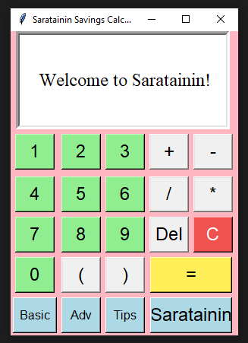
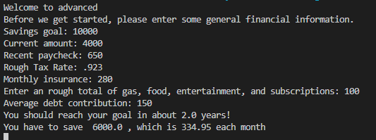
What is it?
Saratainin
Matai Blain, Saramyah Stewart
Software that aids students and low-income HOH’s with saving money each month by calculating how much money is required to reach a desired savings goal. The calculations take income, taxes, and various expenses into account.
Capabilities Include:
- 2 Levels of Calculations
- General Tips and Savings Advice

